Slide 1
BCS 370 Data Structures
Arthur Hoskey, Ph.D.
Farmingdale State College
Computer Systems Department

Slide 2
Today’s Lecture
Chapter 5 ADTs Stacks and Queues (continued)
Created By Arthur Hoskey, PhD

Slide 3
Goals
DONE - Describe a stack and its operations at a logical level
DONE - Demonstrate the effect of stack operations using a particular implementation of a stack
DONE - Implement the Stack ADT, in both an array-based implementation and a linked implementation
Describe the structure of a queue and its operations at a logical level

Slide 4
Goals
Demonstrate the effect of queue operations using a particular implementation of a queue
Implement the Queue ADT, using both a an array-based implementation and a linked implementation
Use inheritance to create a Counted Queue ADT

Slide 5
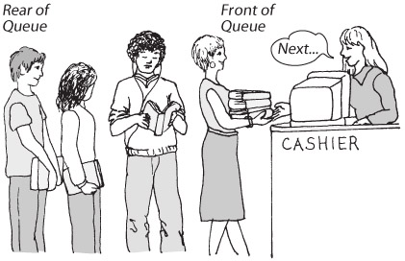
Queues

Slide 6
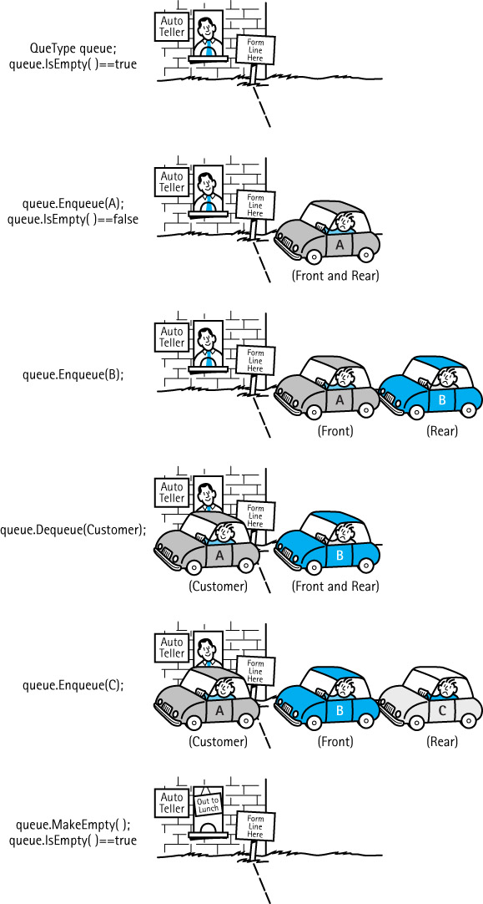
Queues

Slide 7
Queues
What do these composite objects all have in common?

Slide 8
Queues
Queue
An abstract data type in which elements are added to the rear and removed from the front; a “first in, first out” (FIFO) structure

Slide 9
Queues
What operations would be appropriate for a queue?

Slide 10
Queues
Transformers
  MakeEmpty
  Enqueue
  Dequeue
Observers
  IsEmpty
  IsFull
change state
observe state

Slide 11
Queues
class QueType
{
public:
QueType(int max);
QueType();
~QueType();
bool IsEmpty() const;
bool IsFull() const;
void Enqueue(ItemType item);
void Dequeue(ItemType& item);
Logical Level

Slide 12
Queue (Array)
private:
int items[100]; // 100 element queue
int front;
int rear;
// Whatever else we need
}
Implementation level

Slide 13
Queue (Array)
class QueType {
public:// Public members go here…
private:
int front;
int rear;
int max = MAX_ITEMS;
int items[MAX_ITEMS];
};
Physical Level
[0] [1] [2] …. [M..]
queue
.items
.front
.rear

Slide 14
Queue (Array)
What does a queue look like if we insert the following elements (in the given order):
11, 14, 32
Created By Arthur Hoskey, PhD

Slide 15
Queue (Array)
Insert: 11, 14, 32
Here is the resulting queue…
Queue
11
14
32
Front
Rear
Created By Arthur Hoskey, PhD

Slide 16
Queue (Array)
What if we remove an element?
Where does it get removed from?
Can we remove from in the middle?
Queue
11
14
32
Front
Rear
Created By Arthur Hoskey, PhD

Slide 17
Queue (Array)
What if we remove an element?
Where does it get removed from? THE FRONT
Can we remove from in the middle? NO
Queue
11
14
32
Front
Rear
Created By Arthur Hoskey, PhD

Slide 18
Queue (Array)
Queue after removing one element.
Can we add an element after we remove. For example, Enqueue(77)?
Where does it get added?
Queue
14
32
Front
Rear
Created By Arthur Hoskey, PhD

Slide 19
Queue (Array)
Queue after removing one element.
Can we add an element after we remove. For example, Enqueue(77)?
Where does it get added? REAR
Queue
14
32
77
Front
Rear
Created By Arthur Hoskey, PhD

Slide 20
Queue (Array)
QueType::QueType() {
max = 10;
front = max – 1;
read = max – 1;
}
bool QueType::IsEmpty() const
{
return ( rear == front);
}
bool QueType::IsFull() const
{
return ( (rear + 1) % max == front);
}
Note: This queue only holds 9 elements. If you want the queue to hold 10 elements then you need to set max to 11.
Constructor
IsEmpty
IsFull

Slide 21
Queue (Array) - Enqueue
void QueType::Enqueue(int newItem)
{
if (IsFull())
throw FullQueue();
else {
rear = (rear + 1) % max;
items[rear] = newItem;
}
}
FullQueue is an exception.
Update rear.
Add 1 to rear to make it go to the next index. Max is the size of the underlying array so you need to mod by that in case rear went off the end.

Slide 22
Queue (Array)
Now we will look at the array-based implemenation of a queue…
Created By Arthur Hoskey, PhD

Slide 23
Queue (Array)
Rear is the actual index of the last element.
Front is positioned one before the front element.
If Front and Rear are equal then the queue is empty.
Queue
0 1 2 3 4 5 6 7 8 9
Front Max
Rear
0
0
0
0
0
0
0
0
0
0
9
10
9
Created By Arthur Hoskey, PhD

Slide 24
Queue (Array)
What does a queue look internally using an array-based implementation. Assume we run the following code…
Queue q;
q.Enqueue(11);
q.Enqueue(14);
q.Enqueue(32);
Created By Arthur Hoskey, PhD

Slide 25
Queue (Array)
Rear is the actual index of the last element.
Front is positioned one before the front element.
Queue
0 1 2 3 4 5 6 7 8 9
Front Max
Rear
11
14
32
0
0
0
0
0
0
0
9
10
2
Created By Arthur Hoskey, PhD

Slide 26
Queue (Array)
Now remove an element from the queue…
int item;
q.Dequeue(item);
What happens?
Queue
0 1 2 3 4 5 6 7 8 9
Front Max
Rear
11
14
32
0
0
0
0
0
0
0
9
10
2
Created By Arthur Hoskey, PhD

Slide 27
Queue (Array)
Front is moved up one element. Logically removes first element.
Note: Front stands for the index that is one before the first element.
int item;
q.Dequeue(item);
Queue elements
Queue
0 1 2 3 4 5 6 7 8 9
Front Max
Rear
11
14
32
0
0
0
0
0
0
0
0
10
2
Created By Arthur Hoskey, PhD

Slide 28
Queue (Array)
Now run the following…
q.Enqueue(77);
Queue
0 1 2 3 4 5 6 7 8 9
Front Max
Rear
11
14
32
0
0
0
0
0
0
0
0
10
2
Created By Arthur Hoskey, PhD

Slide 29
Queue (Array)
Note: Only 14, 32 and 77 are actually on the queue.
Queue
0 1 2 3 4 5 6 7 8 9
Front Max
Rear
11
14
32
77
0
0
0
0
0
0
0
10
3
Created By Arthur Hoskey, PhD

Slide 30
Queue (Array)
Now look at the next queue and determine which elements are on it…
Created By Arthur Hoskey, PhD

Slide 31
Queue (Array)
Which elements are actually on the queue
Queue
0 1 2 3 4 5 6 7 8 9
Front Max
Rear
55
42
12
77
9
33
26
51
67
80
6
10
2
Created By Arthur Hoskey, PhD

Slide 32
Queue (Array)
LOGICALLY THE QUEUE IS:
Queue Elements: 51, 67, 80, 55, 42, 12
Queue
0 1 2 3 4 5 6 7 8 9
Front Max
Rear
55
42
12
77
9
33
26
51
67
80
6
10
2
Created By Arthur Hoskey, PhD

Slide 33
Queue (Array)
Now run the following code…
q.MakeEmpty()
What happens?
Queue
0 1 2 3 4 5 6 7 8 9
Front Max
Rear
55
42
12
77
9
33
26
51
67
80
6
10
2
Created By Arthur Hoskey, PhD

Slide 34
Queue (Array)
Now run the following code…
q.MakeEmpty()
LOGICALLY THE QUEUE IS EMPTY!
Queue
0 1 2 3 4 5 6 7 8 9
Front Max
Rear
55
42
12
77
9
33
26
51
67
80
9
10
9
Created By Arthur Hoskey, PhD

Slide 35
Counted Queue
The book describes another queue type called a “counted queue”.
A “counted queue” just stores the length along with the other data.
The book uses inheritance to create the “counted queue”.
For example…
Created By Arthur Hoskey, PhD

Slide 36
Counted Queue
class CountedQueType: public QueType
{
public:
CountedQueType(int max);
void Enqueue(ItemType item);
void Dequeue(ItemType& item);
private:
int length;
};
Inherit from QueType
Holds the length of the queue
Why are IsEmpty(), IsFull() and MakeEmpty() missing if this new class is a queue?

Slide 37
Queue (Linked)
Now we will move on to the linked list representation of a queue…
Created By Arthur Hoskey, PhD

Slide 38
Queue (Linked)
class QueType
{
public:
QueType(int max);
QueType();
~QueType();
bool IsEmpty() const;
bool IsFull() const;
void Enqueue(ItemType item);
void Dequeue(ItemType& item);
Logical Level
Same methods as for the array-based implementation

Slide 39
Queue (Linked)
Same node as for the list and stack
struct NodeType
{
int info;
NodeType *next;
};

Slide 40
Queue (Linked)
class QueType
{
public:
// public methods
private:
NodeType *front;
NodeType *rear;
// Whatever else we need
};
Implementation level

Slide 41
Queue (Linked)
Assume the queue has 3 elements on to it
q.Enqueue(11);
q.Enqueue(14);
q.Enqueue(32);
Front
Queue
Rear
data: 11
data: 14
data: 32
next:
next:
next:
Created By Arthur Hoskey, PhD

Slide 42
Queue (Linked)
Where would a new element go?
q.Enqueue(77);
Front
Queue
Rear
data: 11
data: 14
data: 32
next:
next:
next:
Created By Arthur Hoskey, PhD

Slide 43
Stack (Linked) - Push
    You MUST put the new item at the end of the queue.
    Enqueue Pseudocode
    Create a new NodeType item (dynamically allocate).
    Set the fields on the new NodeType item. This means setting the data item and the next pointer. The next pointer should be set to the current top.
    Set the current last element to point to the new node.
    (slightly different if queue is empty)
    Set the rear to the new element.
Created By Arthur Hoskey, PhD

Slide 44
Queue (Linked)
    Create a new NodeType item (dynamically allocate).
Front
Queue
Rear
temp
data: 11
data: 14
data: 32
Data:
next:
next:
next:
next:
Created By Arthur Hoskey, PhD

Slide 45
Queue (Linked)
    Set the fields on the new NodeType item. This means setting the data item and the next pointer. The next pointer should be set to NULL because this new node will become the last element in the queue.
Front
Queue
Rear
temp
data: 11
data: 14
data: 32
data: 77
next:
next:
next:
next:
Created By Arthur Hoskey, PhD

Slide 46
Queue (Linked)
    Set the current last element to point to the new node.
    (slightly different if queue is empty)
Front
Queue
Rear
temp
data: 11
data: 14
data: 32
data: 77
next:
next:
next:
next:
Created By Arthur Hoskey, PhD

Slide 47
Queue (Linked)
    Set the rear to the new element.
Front
Queue
Rear
temp
data: 11
data: 14
data: 32
data: 77
next:
next:
next:
next:
Created By Arthur Hoskey, PhD

Slide 48
Queue (Linked)
    When the Enqueue method ends the temp pointer will disappear.
Front
Queue
Rear
temp
data: 11
data: 14
data: 32
data: 77
next:
next:
next:
next:
Created By Arthur Hoskey, PhD

Slide 49
Queue (Linked)
    This picture is LOGICALLY EQUIVALENT to the previous slide!!!
Front
Queue
Rear
data: 11
data: 14
data: 32
data: 77
next:
next:
next:
next:
Created By Arthur Hoskey, PhD

Slide 50
void QueType::Enqueue(int newItem) {
if (IsFull()) {
throw FullQueue();
} else {
NodeType* temp;
temp = new NodeType;
location->info = newItem;
location>next = NULL;
if (rear == NULL)
front = temp;
else
rear->next = temp;
rear = temp;
}
}
1. Allocate a new node
2. Set values on the new node
3. Adding to an empty as opposed to a queue that already has data is different
4. Make the new element the rear

Slide 51
Stack (Linked) - Push
    You MUST put the new item at the end of the queue.
    Dequeue Pseudocode
    Get a temp pointer to the front node.
    Set the data on the item that will be sent back.
    Set the front pointer to the second node in the queue.
    If the queue is now empty set the rear pointer to NULL.
    Release memory for the original first node in the queue.
Created By Arthur Hoskey, PhD

Slide 52
Queue (Linked)
    Get a temp pointer to the front node.
Front
Queue
temp
Rear
data: 11
data: 14
data: 32
data: 77
next:
next:
next:
next:
item
Created By Arthur Hoskey, PhD

Slide 53
Queue (Linked)
    Set the data on the item that will be sent back.
Front
Queue
temp
Rear
data: 11
data: 14
data: 32
data: 77
next:
next:
next:
next:
item
11
Created By Arthur Hoskey, PhD

Slide 54
Queue (Linked)
    Set the front pointer to the second node in the queue.
Front
Queue
temp
Rear
data: 11
data: 14
data: 32
data: 77
next:
next:
next:
next:
item
11
Created By Arthur Hoskey, PhD

Slide 55
Queue (Linked)
    If the queue is now empty set the rear pointer to NULL.
    THE QUEUE IS NOT EMPTY SO NOTHING CHANGES ON THIS STEP.
Front
Queue
temp
Rear
data: 11
data: 14
data: 32
data: 77
next:
next:
next:
next:
item
11
Created By Arthur Hoskey, PhD

Slide 56
Queue (Linked)
    Release memory for the original first node in the queue.
Front
Queue
temp
Rear
data: 11
data: 14
data: 32
data: 77
next:
next:
next:
next:
item
11
Created By Arthur Hoskey, PhD

Slide 57
Queue (Linked)
    The temp pointer will disappear when the Dequeue method ends.
Front
Queue
temp
Rear
data: 11
data: 14
data: 32
data: 77
next:
next:
next:
next:
item
11
Created By Arthur Hoskey, PhD

Slide 58
Queue (Linked)
    This picture is LOGICALLY EQUIVALENT to the previous slide!!!
Front
Queue
Rear
data: 14
data: 32
data: 77
next:
next:
next:
item
11
Created By Arthur Hoskey, PhD

Slide 59
void QueType::Dequeue(int& newItem) {
if (IsEmpty()) {
throw EmptyQueue();
} else {
NodeType* temp;
temp = front;
item = front->info;
front = front->next;
if (front == NULL)
rear = NULL;
delete temp;
}
}
1. Get a temp pointer to front
2. Get the data to return
3. Move front to the second element
4. If queue is empty the set rear to NULL
5. Release the memory for the removed node

Slide 60
Queue (Linked)
bool QueType::~MakeEmpty()
{
NodeType * temp;
while (front != NULL)
{
temp = front;
front = front->next;
delete temp;
}
rear = NULL;
}
Deletes ALL of the elements in the queue.
Created By Arthur Hoskey, PhD

Slide 61
Queue (Linked) – Destructor
bool QueType::~QueType()
{
MakeEmpty();
}
Deletes ALL of the elements in the queue.
Note: The array-based implementation does not need a destructor because it does NOT dynamically allocate memory.
Created By Arthur Hoskey, PhD

Slide 62
Circular Queue
Last element points to first element.
Only stores one pointer – rear
Created By Arthur Hoskey, PhD

Slide 63
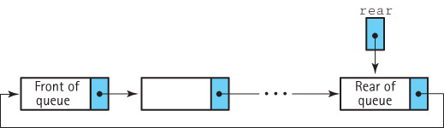
Circular Queue
A circular linked queue uses only one external pointer: rear
How do you access front?

Slide 64
Circular Queue
A circular linked queue uses only one external pointer: rear
How do you access front?
Answer: Front is the next element after rear.

Slide 65
Big-O Comparison – Queue
What are the Big-O runtimes for the array-based and linked-list implementations of a queue?
Created By Arthur Hoskey, PhD

Slide 66
Big-O Comparison – Queue (Array)
Operation | Cost
MakeEmpty | O(1)
IsFull | O(1)
IsEmpty | O(1)
Push | O(1)
Pop | O(1)
Constructor | O(1)
Destructor | n/a
Created By Arthur Hoskey, PhD

Slide 67
Big-O Comparison – Queue(Linked)
Operation | Cost
MakeEmpty | O(n)
IsFull | O(1)
IsEmpty | O(1)
Push | O(1)
Pop | O(1)
Constructor | O(1)
Destructor | O(n)
Created By Arthur Hoskey, PhD

Slide 68
Attendance
Take attendance now!!!
Created By Arthur Hoskey, PhD

Slide 69
End of Slides
End of Slides
Created By Arthur Hoskey, PhD

